Slide 1
HIV Drugs
Spreadsheet Documentation

Slide 2
General Information
Link to spreadsheet: https://docs.google.com/a/binghamton.edu/spreadsheet/ccc?key=0Ag8gS12PpxX2dF82NS1CLVhwd1RDSjhiMnFpdGtUZVE&usp=drive_web#gid=20
Location of spreadsheet in Google Docs:
Global Burden of Disease/Rating System/HIV Rating/
Spreadsheet contains data regarding
Summary of company rankings
WHO groupings and Country categorizations
The burden of Malaria and the data of its drugs by countries
The burden of Tuberculosis and the data of its drugs by countries
The burden of HIV and the data of its drugs by countries

Slide 3
Tab (5) HIV by Country: General Information
Column A: List of countries
Column B: Each country is categorized into WHO regions
Column C: Population in each country
Column D: Each country is categorized into geographical region
Column E: Based on geographical region, each country is mapped into either Group A or B
Group B = Latin America and the Caribbean
Group A = All other regions

Slide 4
Tab (5) HIV by Country: The Total Impact Score of A Drug
Need
Access
Efficacy
Its score in Group A countries
Its score in Group B countries
Treating Adults
Treating Children
Treating Adults
Treating Children

Slide 5
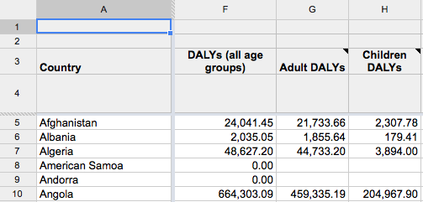
Tab (5) HIV by Country: Needs
Column F: Total DALYs lost to malaria in all age groups within each country
Column G & H: Total DALYs lost break down to DALYs lost of adults (G) and of children (H)

Slide 6
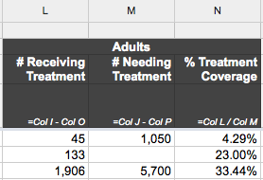
Tab (5) HIV by Country: Access
Column L-N: % treatment coverage of adults
% treatment coverage of adults (N) = # receiving treatment (L) / # needing treatment (M)
% treatment coverage N = L / M

Slide 7
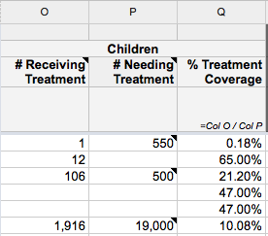
Tab (5) HIV by Country: Access
Column O-Q: % treatment coverage of children
% treatment coverage of children (Q) = # receiving treatment (O) / # needing treatment (P)
% treatment coverage of children Q = O / P

Slide 8
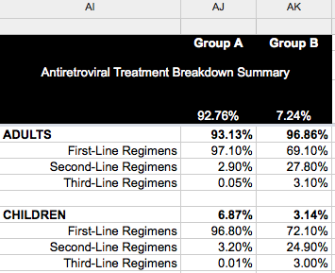
Tab (5) HIV by Country: Access
Column AJ-AK and row 5-13: treatment coverage breakdown to first /second /third-line treatment for adult and children

Slide 9
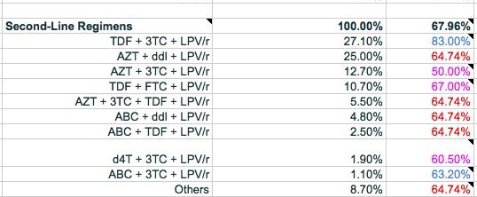
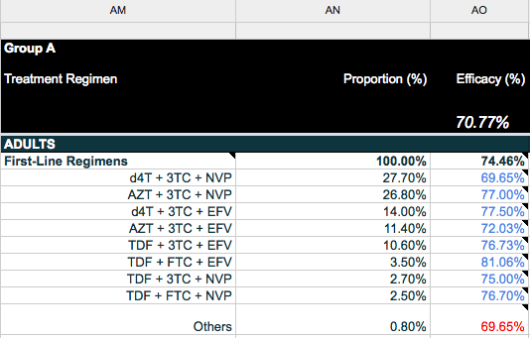
Tab (5) HIV by Country: Efficacy
Column AM-AO: Treatment regimen in Group A countries
AM: List of treatment first/second-line regimens for adults and for children
AN: List of proportion of each regimens within its category
AO: List of efficacy of each regimen (Average of data from Cameroon and Uganda (group A countries) for adult, first-line regimens in Group A quadrant.)

Slide 10
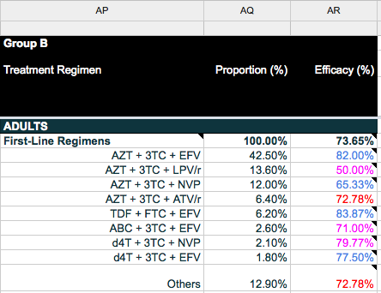
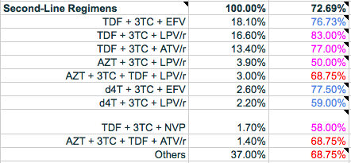
Tab (5) HIV by Country: Efficacy
Column AP to AR: Treatment regimen in Group B countries
AP: List of treatment first/second-line regimens for adults and for children
AQ: List of proportion of each regimens within its category
AR: List of efficacy of each regimen (Average of data from 8 studies for adult, first-line regimens in Group B quadrant)

Slide 11
Tab (5) HIV by Country: Example: The Impact Score of d4T
Its score in Group B countries
Its score in Group A countries
Treating Adults
Treating Children
Treating Adults
Treating Children
Two 1st line
One 2nd line
Three1st line
Two 2nd line
Two 1st line
Two 2nd line
None

Slide 12
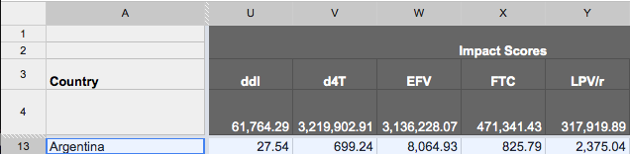
Tab (5) HIV by Country: Calculating Impact Scores: d4T
Total impact score of d4T in Argentina (V13)
The total impact score of d4T in Argentina = The sum of its impact score of treating adults and children in Argentina

Slide 13
Example: d4t in Argentina
Group A or group B country?
E13
Group B
List of treatment regimens in group B countries
AP5 to AP 48
d4t is only for adults in group B countries
Needs: DALYs lost in Argentina (G13)
Access:
Adult treatment coverage (N13) and breakdowns (AK6-AK7)
Efficacy: AQ-AR
Treatment Proportaion: AQ
One out of three drugs in the regimen: 1/3

Slide 14
Tab (5) HIV by Country: Calculating Impact Scores Ex.-1
The impact score of d4T in treating adults in Argentina :
Column AP: d4T is included in two first-line regimens, d4T+3TC+NVP and d4T+3TC+EFV
d4T+3TC+NVP
Needs: G13 84,815.85 DALYs lost
Access: N13 (81.29% )* AK6 (69.10%)
d4T+3TC+EFV
Efficacy: AR13 (79.77% )
Treatment Proportion: AQ13 (2.10%)
One out of three drugs in the regimen: 1/3
= 266.03
Needs: G13 84,815.85 DALYs lost
Access: N13 (81.29%) * AK6 (69.10%)
Efficacy: AR14 (81.29%)*
Treatment Proportaion: AQ13 (1.80%)
One out of three drugs in the regimen: 1/3
= 221.54

Slide 15
Tab (5) HIV by Country: Calculating Impact Scores Ex.-2
The impact score of d4T in treating adults in Argentina :
Column AP: d4T is included in two second-line regimens, d4T+3TC+EFV and d4T+3TC+LPV/r
d4T+3TC+EFV
Needs: G13 84,815.85 DALYs lost
Access: N13 (81.29% )* AK7 (27.80%)
d4T+3TC+LPV/r
Efficacy: AR23 (77.50% )
Treatment Proportion: AQ23(2.60%)
One out of three drugs in the regimen: 1/3
= 128.74
Needs: G13 84,815.85 DALYs lost
Access: N13 (81.29%) * AK7 (27.80%)
Efficacy: AR24 (59.00%)*
Treatment Proportaion: AQ24 (2.20%)
One out of three drugs in the regimen: 1/3
= 82.93

Slide 16
Tab (5) HIV by Country: Calculating Impact Scores Ex.-3
The impact score of d4T in treating adults in Argentina =
The total impact score of d4T serves as first-line regimens
Its impact score in d4T+3TC+NVP (266.03) + its score in d4T+3TC+EFV (221.54) = 487.57
The total impact score of d4t serves as second-line regimens
Its impact score in d4T+3TC+EFV (128.74) + its score in d4T+3TC+LPV/r (82.93) = 211.67

Slide 17
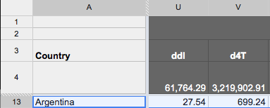
Tab (5) HIV by Country: Calculating Impact Scores Ex.-4
The impact score of d4T in treating adults in Argentina =
Its impact score in first-line treatment + its impact score in second-line treatment = 487.57+211.67= 699.24
The total impact score of d4T = The sum of impact score of d4T in each countries. The total impact score of a drug = The sum of the score in each countries

Slide 18
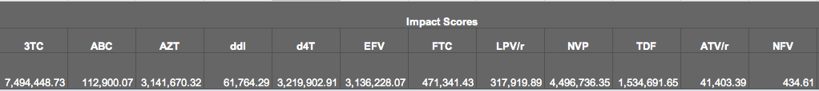
Tab (5) HIV by Country: Total Impact Score of Drugs
R4 to AC4: Total impact scores of each drug
Column AD: Total impact scores in a country = The sum of impact score of each drugs in that country

Slide 19
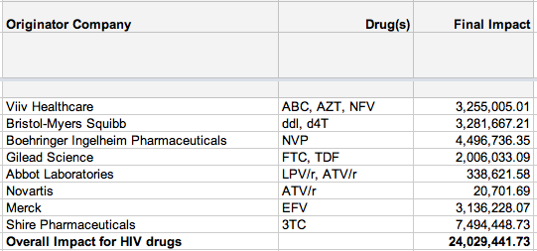
Tab (5) HIV by Country: Total Impact Score of Companies
Column AT to AV and row 3-14: The total impact score of a company = The sum of the score of its drugs
Overall impact for HIV drugs = The sum of the impact score of all drugs.

